Slide 1
SE PROJECT Final Presentation
Group 1: Nardiello Pasquale, Petruzziello Riccardo, Longobardi Domenico, Noviello Nevio Giuseppe

Slide 2
Extended burndown chart
1
(1 SP = 1 h)
(Extra SP not counted)

Slide 3
Commit chart
2

Slide 4
Charts analysis
3
Issues encontoured
Possible Solution
Non-Ideal implementation of story points after the first sprint
redistribute work to reach the ideal SP implementation for each sprint
use of commits not constant and not enough frequent
Commit every single change and not only after some lines of code
non-optimal distribution of work over the week
Planning better on every single day what to do

Slide 5
Workflow
4
Nardiello Pasquale | Petruzziello Riccardo | Longobardi Domenico | Noviello Nevio Giuseppe
User Story 3 User Story 4 User Story 5 User Story 6 User Story 7 User Story 8 User Story 9 User Story 23 User Story 24 User Story 25 User Story 26 User Story 30 User Story 31 User Story 32 Extra Feature 1 Extra Feature 2 Extra Feature 3 Extra Feature 4 Extra Feature 6 | User Story 1 User Story 2 User Story 15 User Story 16 User Story 17 User Story 18 User Story 19 User Story 33 User Story 34 User Story 35 Extra Feature 1 Extra Feature 5 | User Story 10 User Story 11 User Story 12 User Story 13 User Story 14 User Story 20 User Story 21 User Story 22 User Story 27 User Story 28 User Story 29 Extra Feature 1 Extra Feature 5 | Testing Epic 1 Testing Epic 2 Testing Epic 3 Testing Epic 4 Testing Epic 5 Testing Epic 6 Testing Extra Features

Slide 6
Definitions
5
DOD | DOF
A task is considered done when all the specs and the acceptance criteria described in a single user storie have been implemented, when all the testing has been completed successfully and the represented function(s) are present in a demo. | Every method must be in the following format: blank line/Javadoc .. nameMethod(){ ... } blank line Every class must be in the following format: blank line/Javadoc .. ClassName(){ ... } blank line

Slide 7
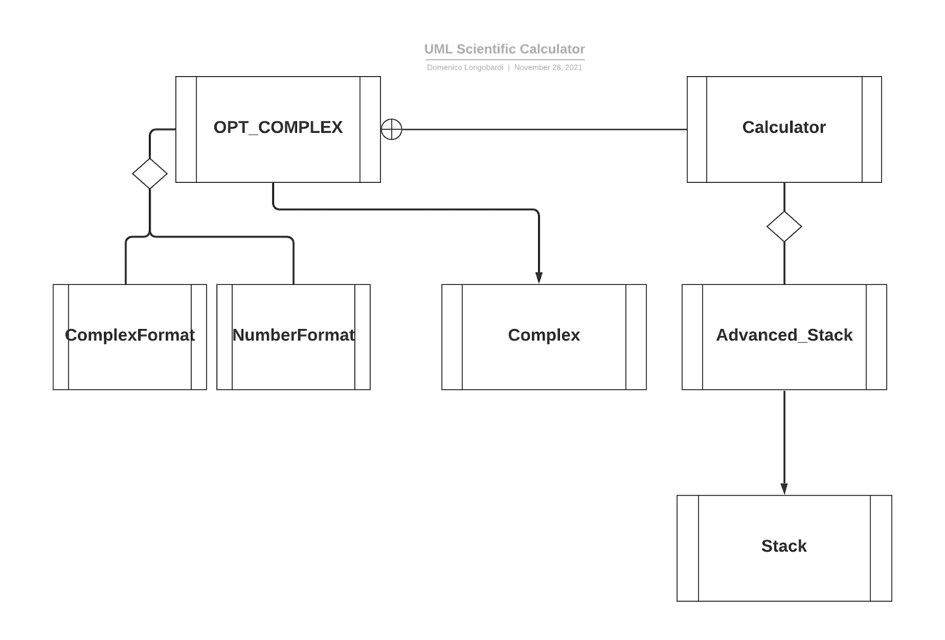
Architecture
6
The software architecture has been defined following the MVC paradigm, where the Model is the following:

Slide 8
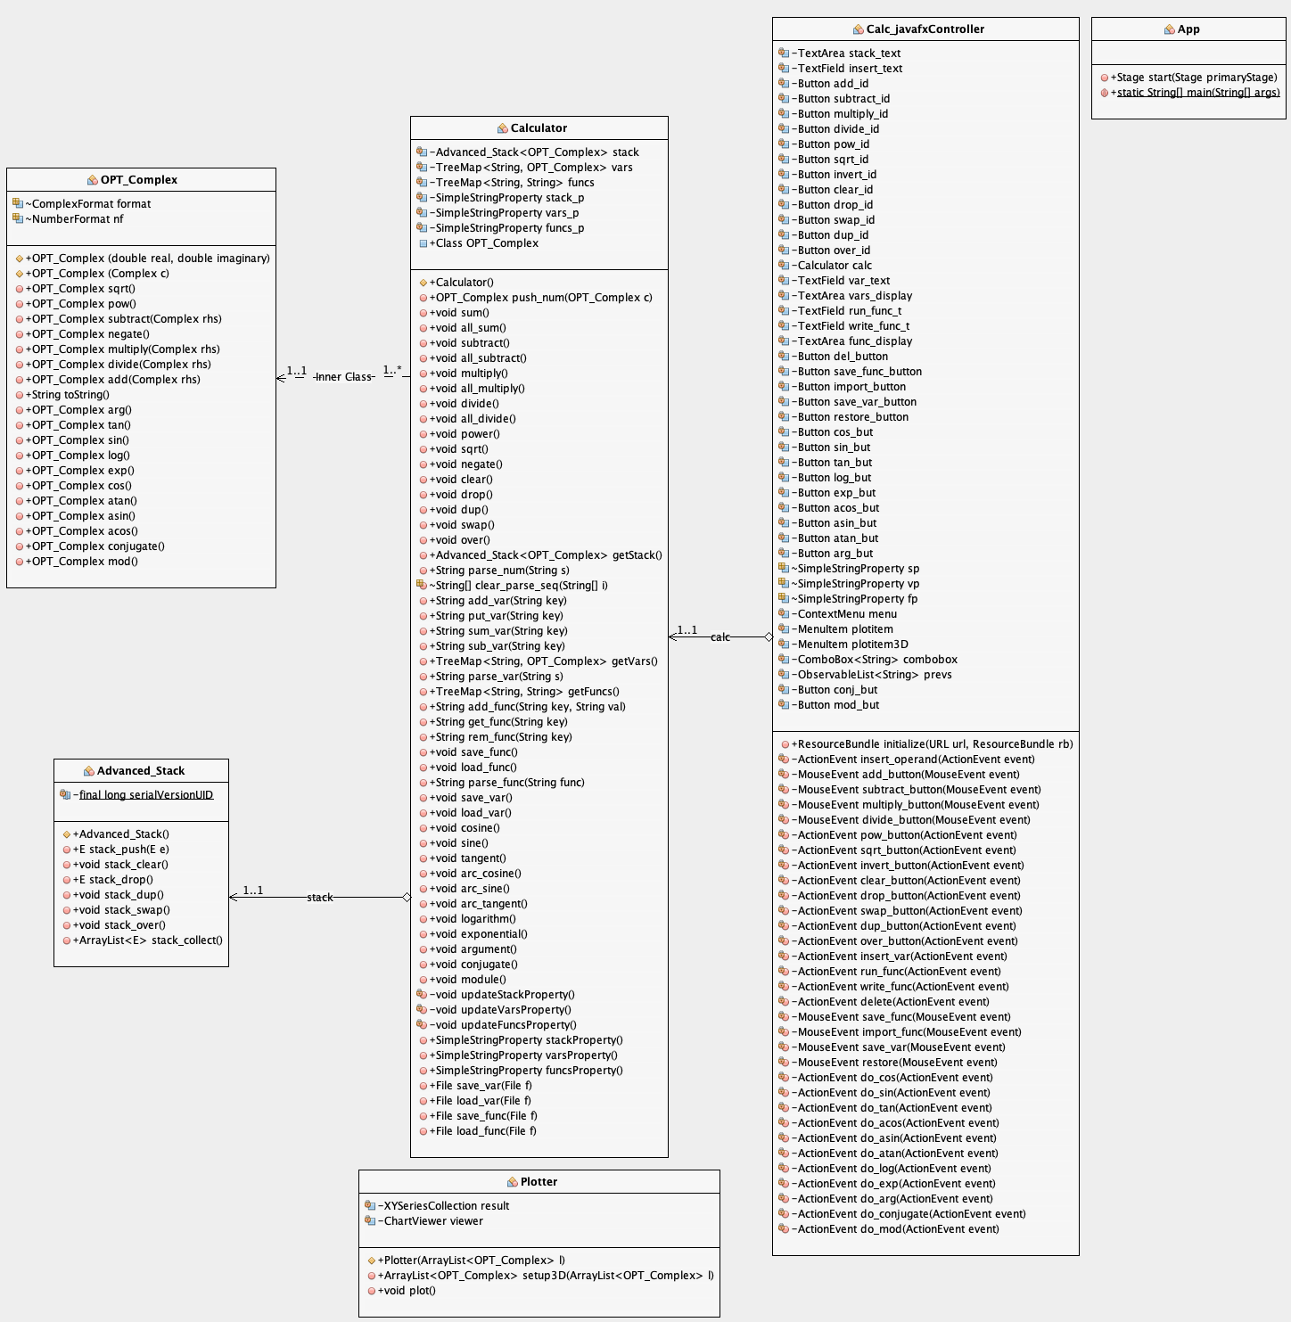
UML
7
Calculator : the main Model class in which we find an instance of Advanced_Stack and the definition of OPT_Complex inner Class
Advanced_Stack : generalization of Stack Class with advanced features
OPT_Complex : wrapped Apache Complex Class
Plotter : Class for graphical plotting
Calc_javafxController : MVC Controller Class
App : launch Class

Slide 9
Patterns
8
Decorator -> Calculator String properties are binded to the controller’s listeners, graphically reflecting Calculator internal changes
Observer -> Calculator properties changes are monitored and registered in an Observable list of Strings, in order to be re-parsed as Chronology
Iterator -> The iterator construct is used to iterate in the auxiliary Stream flow, in order to find the root cause of Exceptions
Adaptee -> Apache Complex Class has been wrapped into an artificial OPT_Complex Class, in order to obtain a better print of numbers with the aggregate Complex_Formatter Class

Slide 10
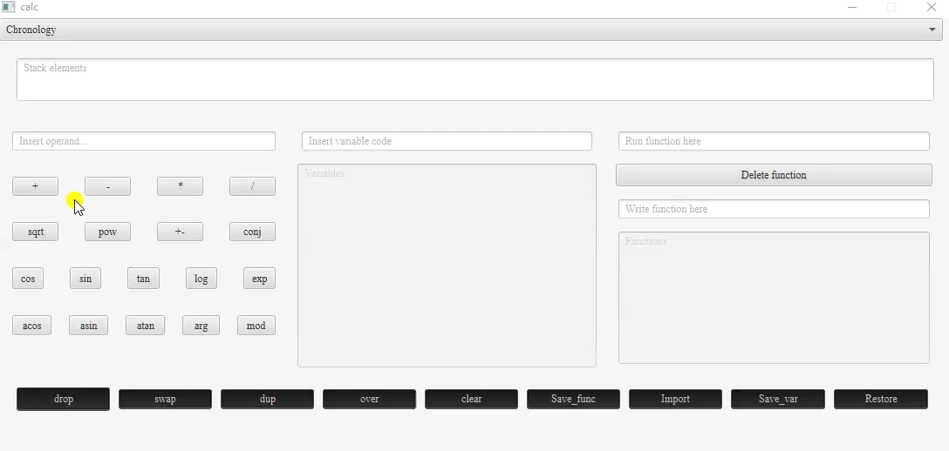
Extra features
9
Having finished during the second sprint all user stories provided, we decided to add some additional features to our product:
Dialogs Alerts – to handle exceptions and notify user about them
For example,it appears when:
Wrong input format(operand,variable,function)
Make operation on wrong operands(e.g: plus operation on one operand or ‘>x’ operation on empty stack)

Slide 11
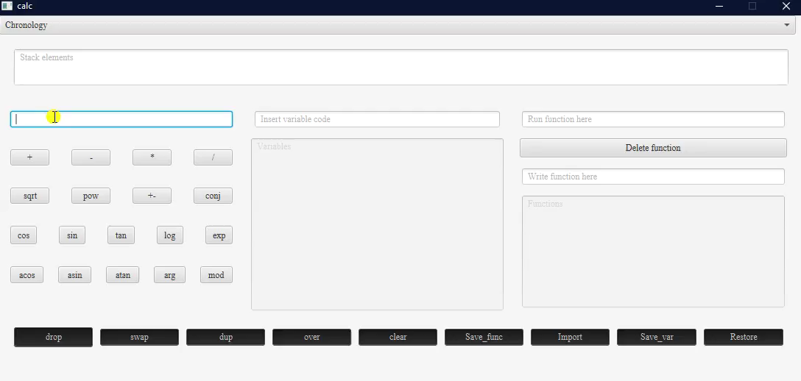
Extra features
10
Calculator’s Chronology – to display and re-use previous operands and results
To use it:
click on ‘chronology’ bar above the Stack elements area
Choose which elements re-store

Slide 12
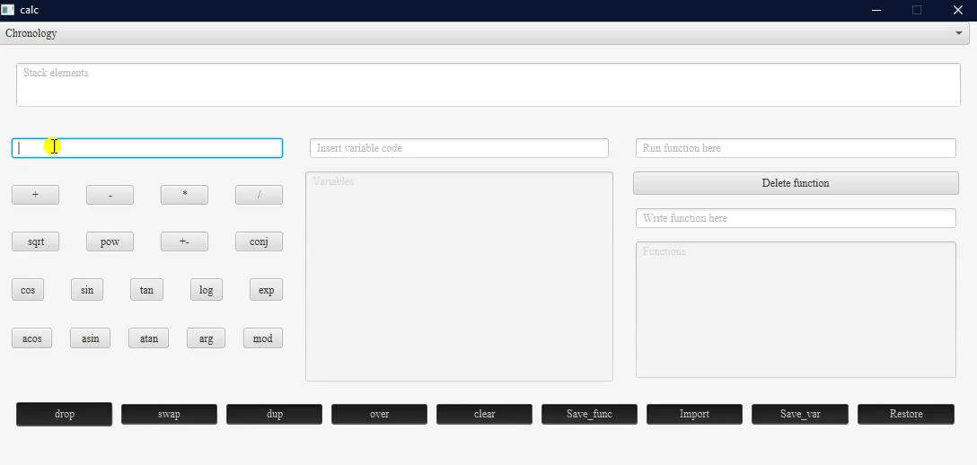
Extra features
11
Double logic operations and save/restore files – to allow the user to perform calculations on the entire stack and choose pre-defined/custom location when saving/restoring files
To use it:
Left click on an operation/save/restore button to perform the binary logic operation or save/restore in/from a pre-defined file
Right click on an operation/save/restore button to perform the sequential logic operation or save/restore in/from a
custom file pre-defined file

Slide 13
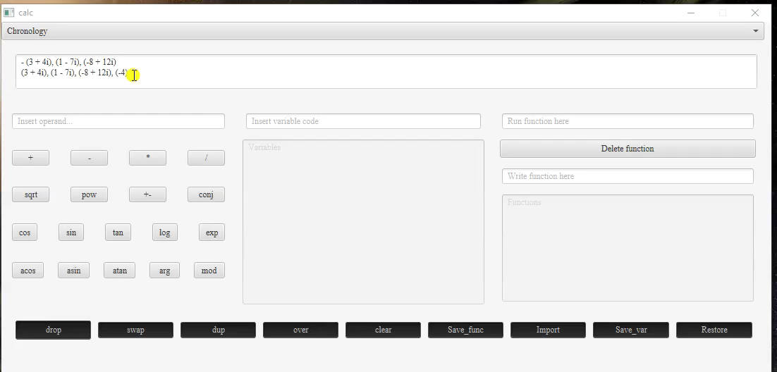
Extra features
12
Plot 2D/3D - to allow the visualization of the space allocation of the complex numbers inserted
To use it:
Right click on Stack elements Area
Choose “Scatter Plot” or
“3D plot”

